Slide 1

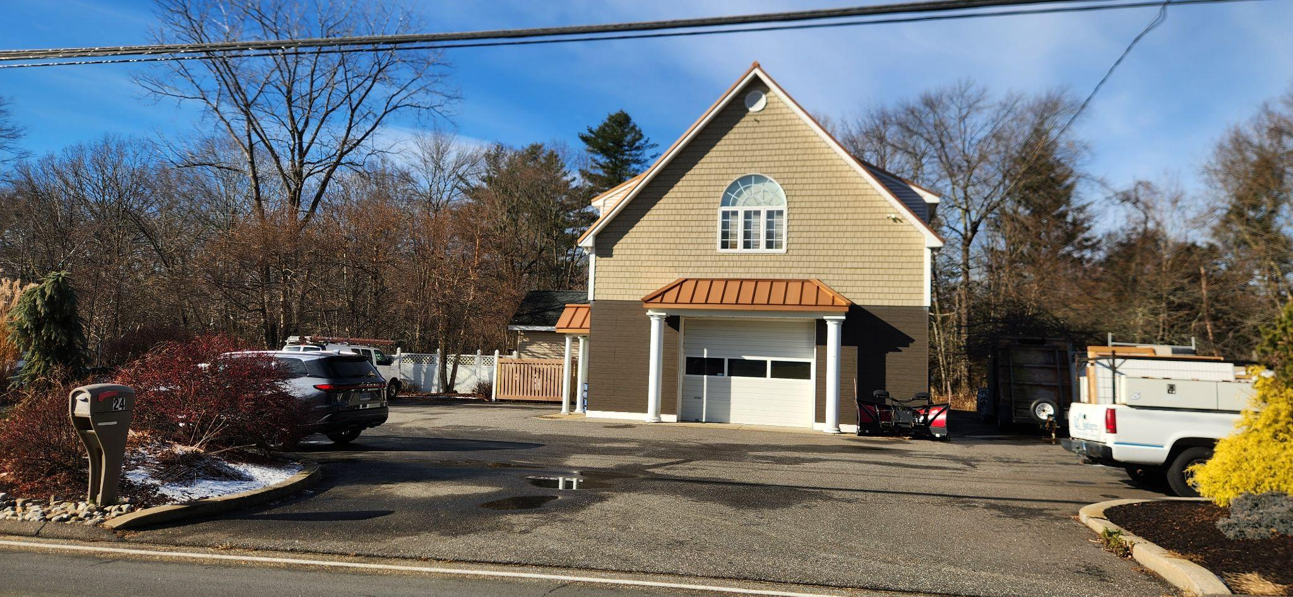
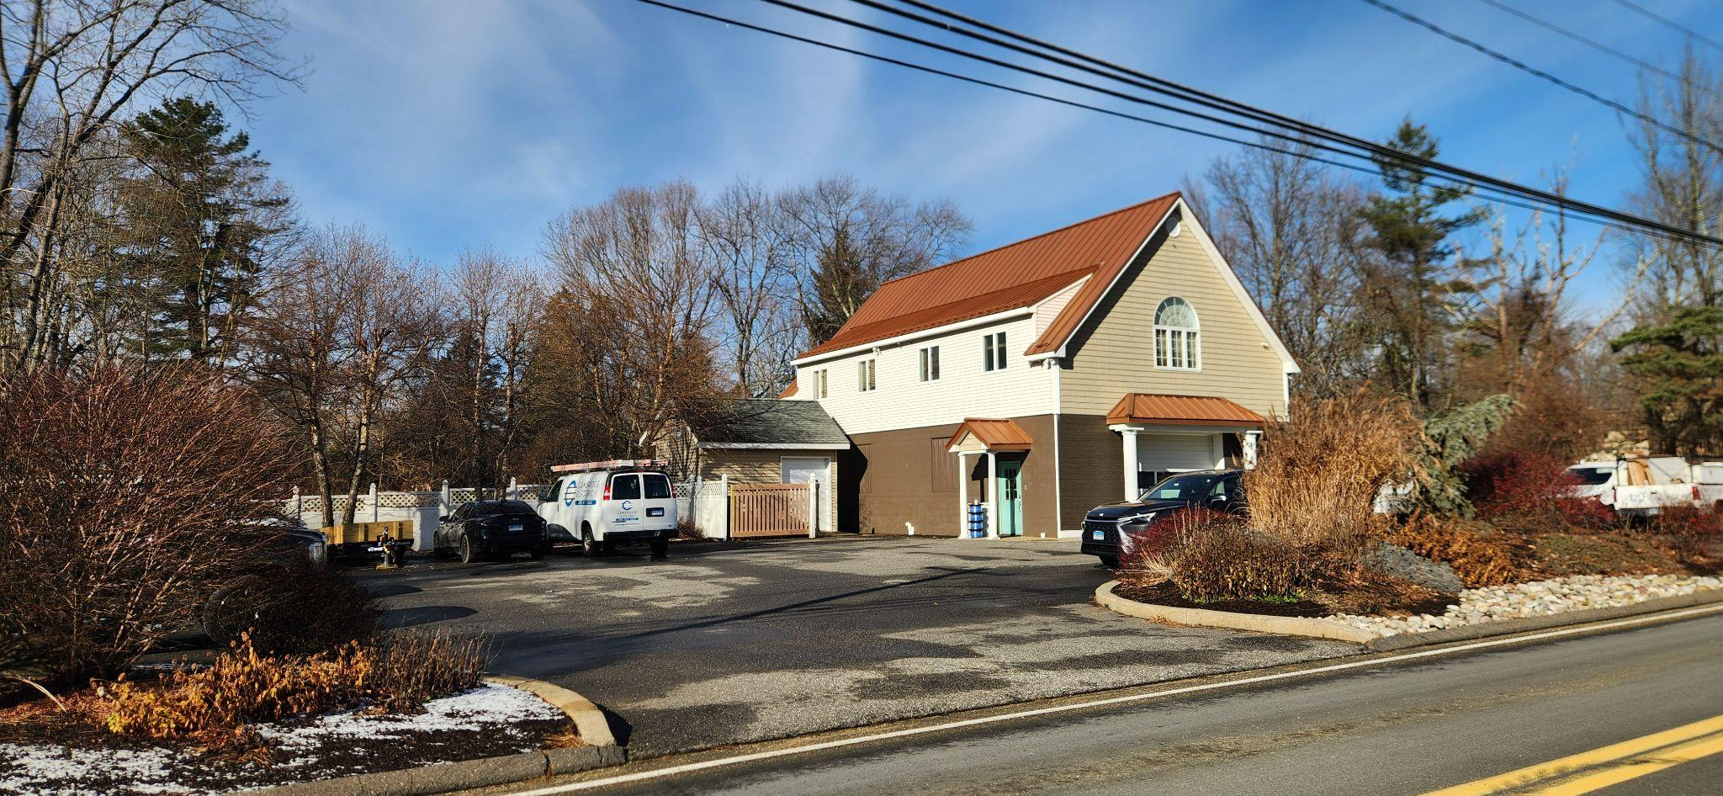

FOR SALE
24 Straitsville Rd, Prospect, CT 06712
Great contractor property
3,060 square feet
3.12 Acres / RA-1 Zone
Non-Conformed Use
Well maintained building
Close to center of town
Insurance Discount - fire hydrant on property
FOR SALE $425,000
MAIN OFFICE: 25' X 32'
2 Small Offices
Kitchenette
Conference Room w/ Open Office
BACK OFFICE: 25' X 18'
1 Office
Front shed 12' X 18'
Back shed 10' X 16'
Full height attic 12' X 40' -Great Storage
Motion Lights Security System
Furniture is negotiable

Slide 2

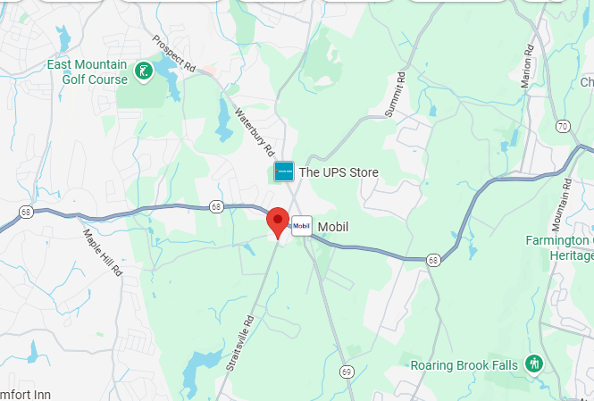
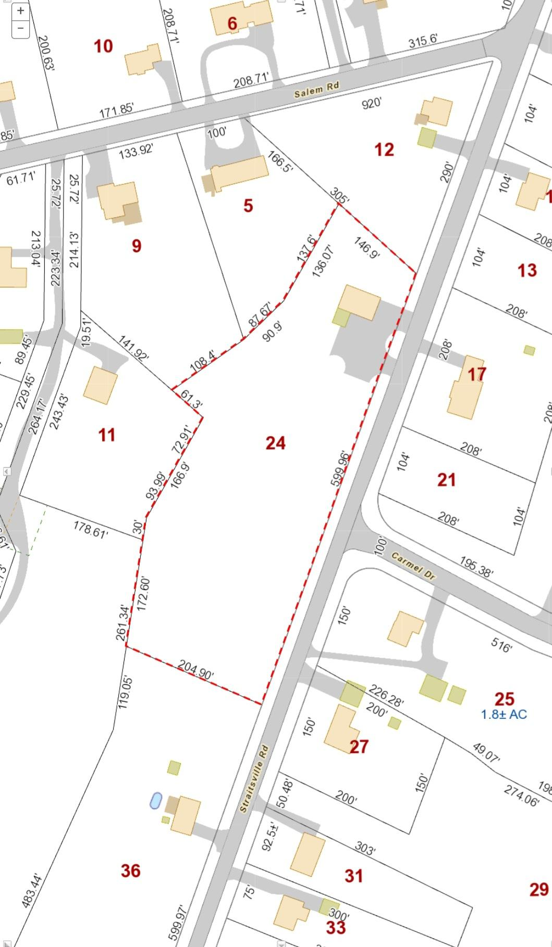
FOR SALE
24 Straitsville Rd, Prospect, CT 06712
BUILDING
Total SF | 3060
Number of Floors | 2
Total Available SF | 3060
Office Space | 1250
Exterior Construction | Block/Framed
Roof | Metal
Interior Construction | Sheetrock
Year Built | 1937/2004
Ceiling Height | 1st- 11’ 2nd- 8’
Bathrooms | Two .5 (1st and 2nd fl)
Parking | Off street
Acres | 3.12
Zoning | RA 1
Overhead Drive-In | 12’Wx10’H
MECHANICALS & UTILITIES
Type of Heat | 1st- 1 yr old propane (Modine) 2nd- Propane HVAC
Amps-Volts-Phase | 200A single phase
Gas | Propane
Sewer | Septic
Water | City
Air Conditioning | HVAC
TERMS
Sale Price | $425,000
GERRY D. MATTHEWS 203.753.5800

Slide 3
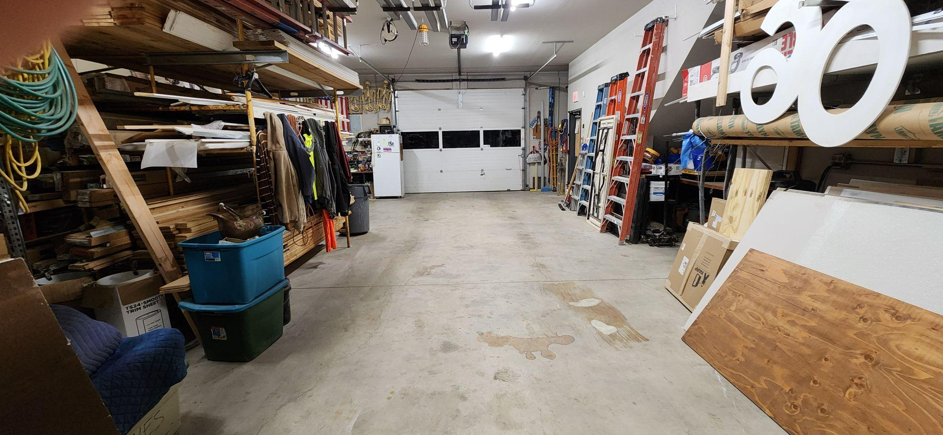
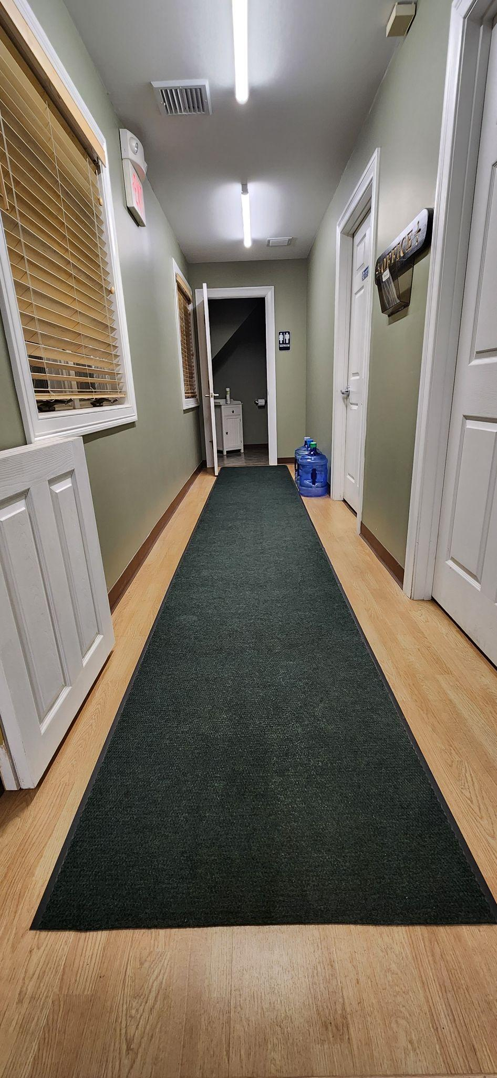
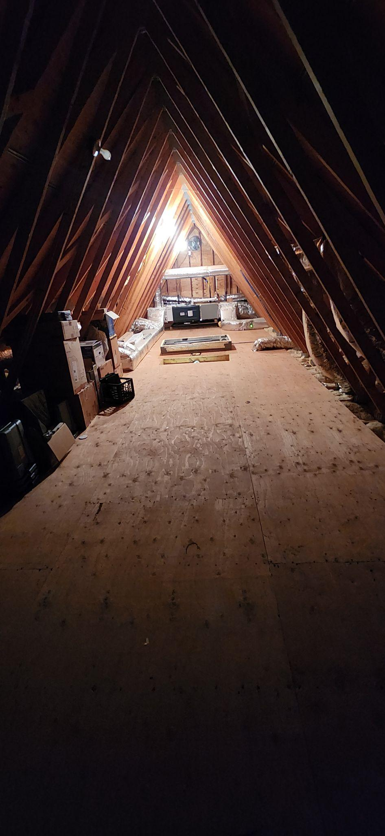
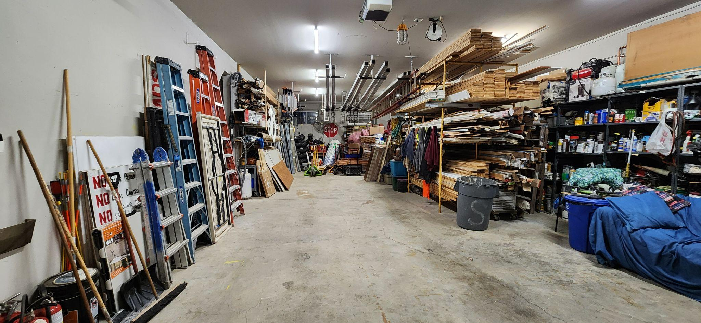
FOR SALE
24 Straitsville Rd, Prospect, CT 06712

Slide 4
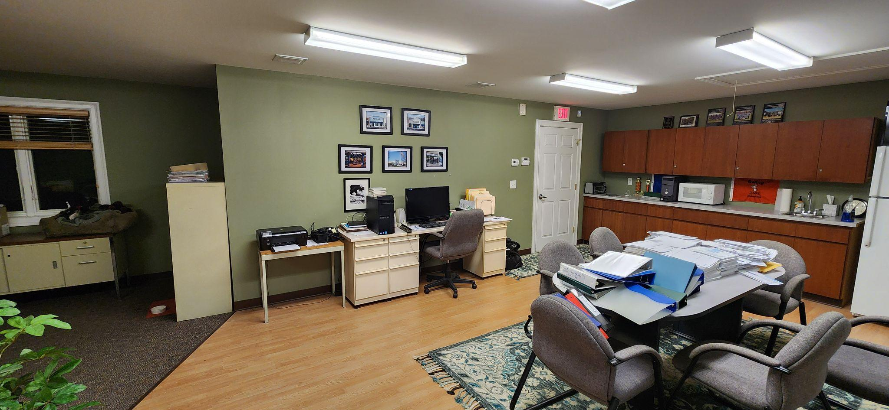
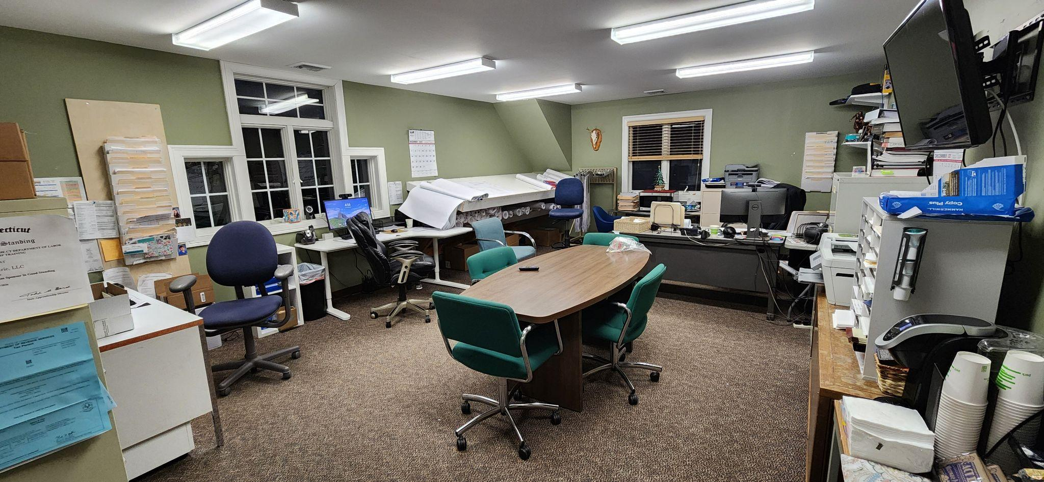
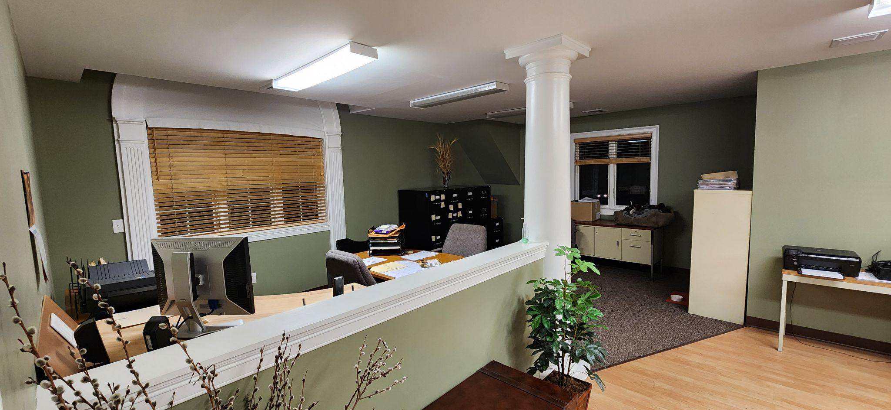
FOR SALE
24 Straitsville Rd, Prospect, CT 06712

